Slide 1
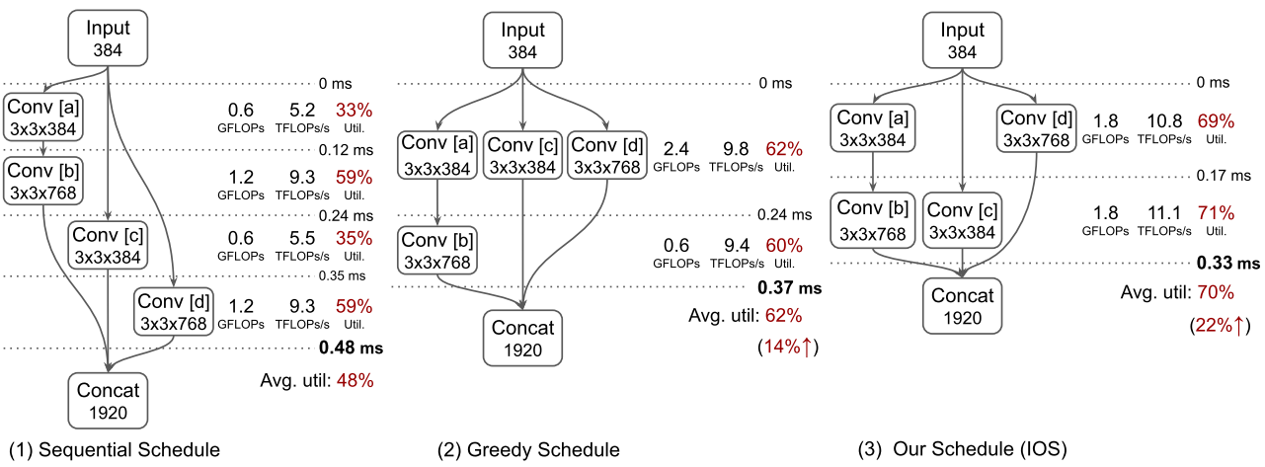

Notes: IOS: INTER-OPERATOR SCHEDULER FOR CNN ACCELERATION ^{[1,2]}
II. Challenges
I. Applications
Number of schedules grows exponentially with the number of operators.
Optimal schedule depends on hardware speciﬁcations and inference settings.
Improve hardware utilization and reduce the latency of processor (such as NVIDIA GPU) using directed acyclic graph (DAG).
III. Methods
Combining intra- and inter-operator parallelism. Please refer to next page.
IV. Conclusions
Source: [3]
Lower latency
Higher
hardware utilization
（3）Proposed method IOS
[1] https://arxiv.org/abs/2011.01302 [2] https://github.com/mit-han-lab/inter-operator-scheduler
[3] https://proceedings.mlsys.org/paper/2019/hash/c74d97b01eae257e44aa9d5bade97baf-Abstract.html

Slide 2
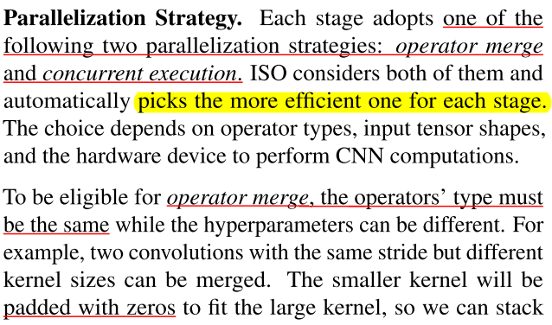
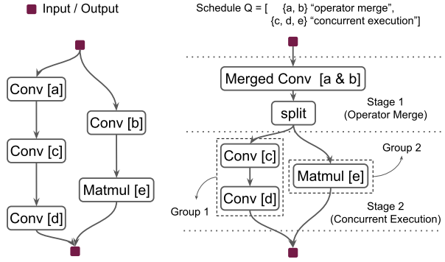
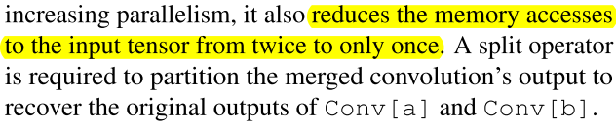
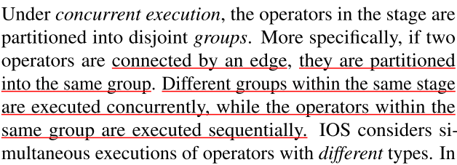
Notes: IOS: INTER-OPERATOR SCHEDULER FOR CNN ACCELERATION ^{[1,2]}
III. Methods
Combining intra- and inter-operator parallelism)
DAG: G=(V, E), where V is the set of operators, and E is the edge set representing dependencies.

Slide 3
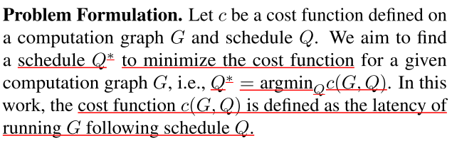
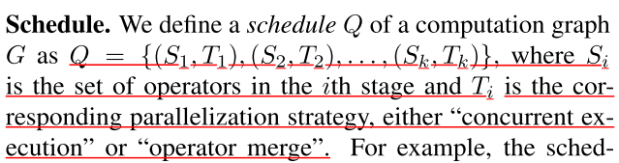
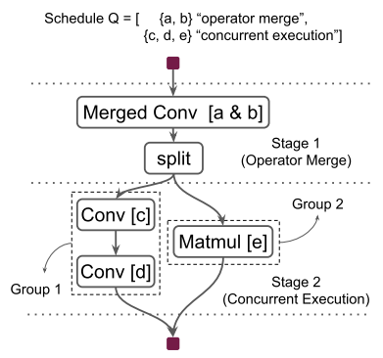
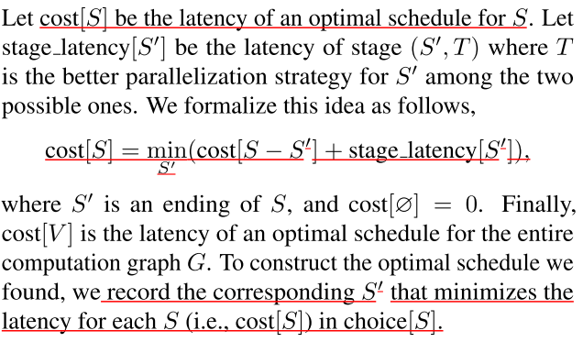
Notes: IOS: INTER-OPERATOR SCHEDULER FOR CNN ACCELERATION ^{[1,2]}
III. Methods
Combining intra- and inter-operator parallelism)
DAG: G=(V, E), where V is the set of operators, and E is the edge set representing dependencies.

